Slide 1
Documenting Life Histories:
Distant Reading a Federal Writers’ Project Archive
Courtney Rivard
University of North Carolina, Chapel Hill
www.courtneyrivard.com
Notes:
FWP Established under the WPA in 1935
started with the American Guide series, which focuses on the historical, cultural and economic resoureces of the US
next two most prominent projects are:
• Slave Narratives project that included over 2300 first person accounts of slavery and 500 black and white photographs
• American Life Histories

Slide 2
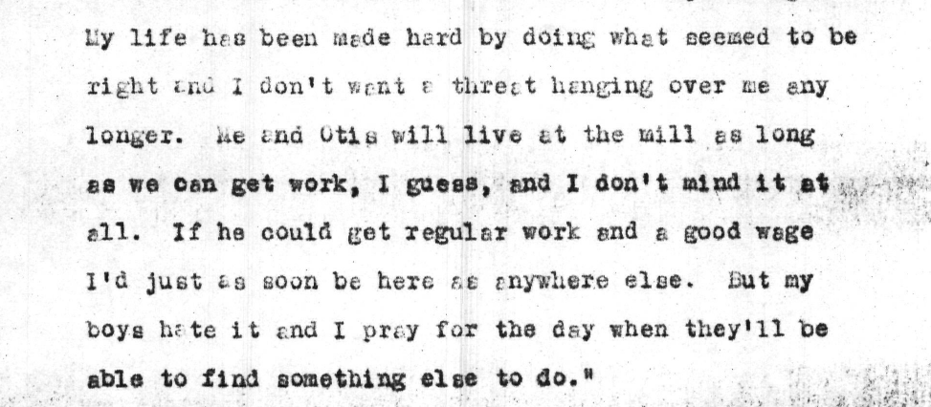
Collection 03709, Folder 1027

Slide 3
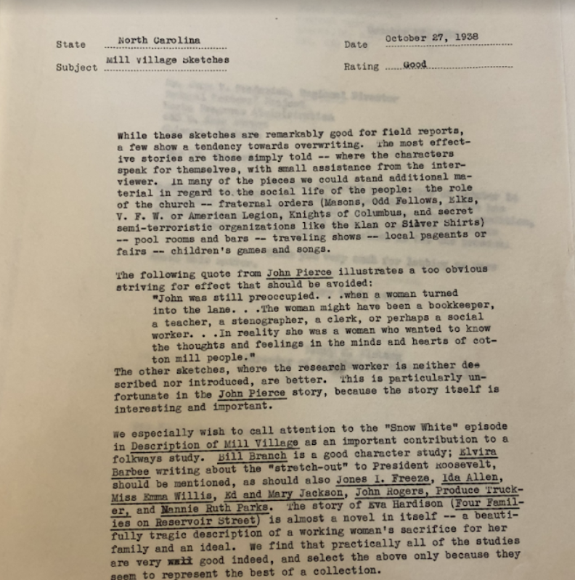
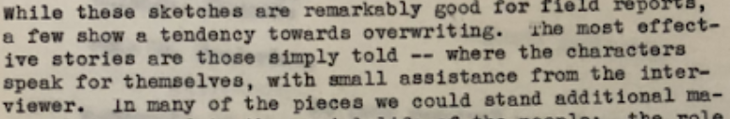

Slide 4
Two Main Arguments
Recover Life History Project
Pairing Close and Distant Readings of Archival Material

Slide 5
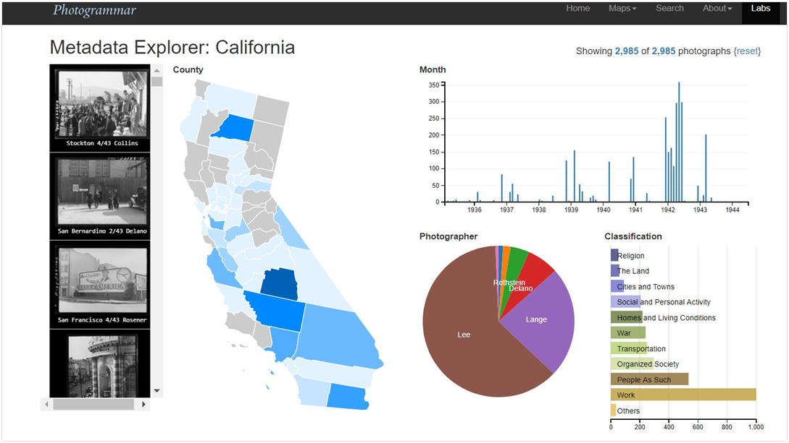
Photogrammar
Dr. Lauren Tilton
Digital Humanities
University of Richmond
Dr. Taylor Arnold
Statistics
University of Richmond

Slide 6
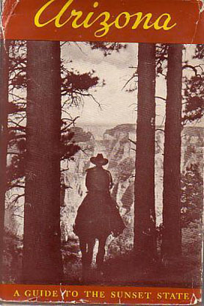
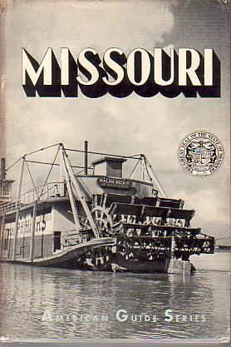


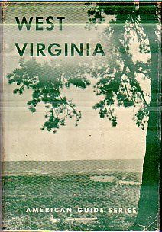
American Guide Series
Notes:
FWP Established under the WPA in 1935
started with the American Guide series, which focuses on the historical, cultural and economic resoureces of the US
next two most prominent projects are:
• Slave Narratives project that included over 2300 first person accounts of slavery and 500 black and white photographs
• American Life Histories

Slide 7
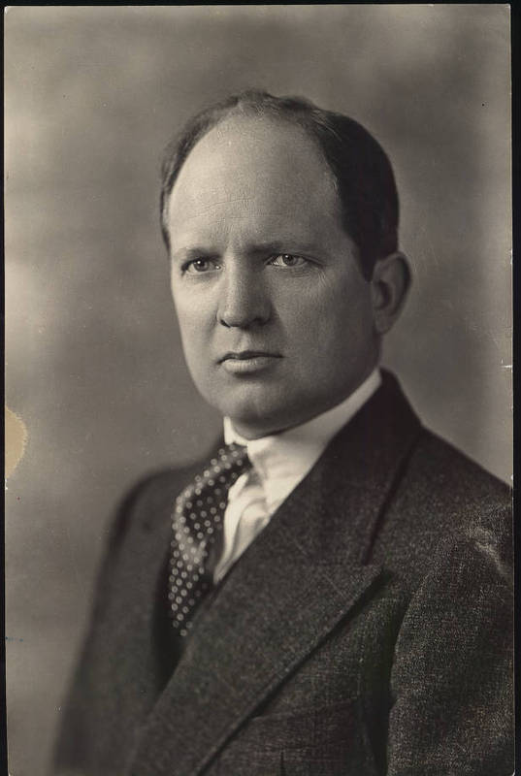
William Couch
Head of UNC Press
Director of North Carolina, Federal Writers Project

Slide 8
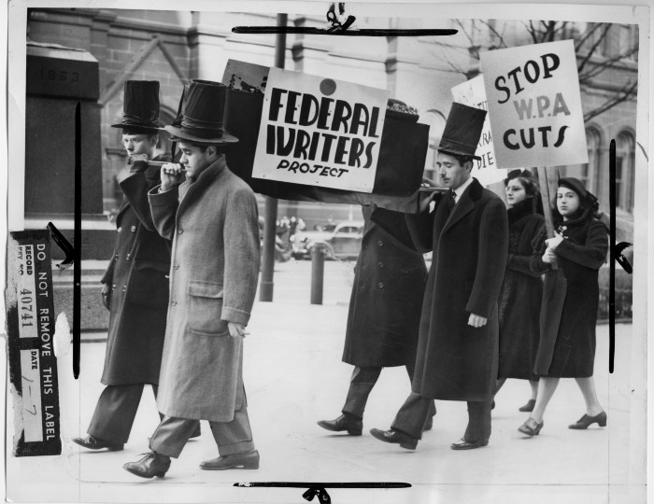
Life Histories Collection
“The people, all the people, must be known, they must be heard. Somehow they must be given representation, somehow they must be given voice and allowed to speak, in their essential character…life histories can help with this job”
W.T. Couch, 1939

Slide 9
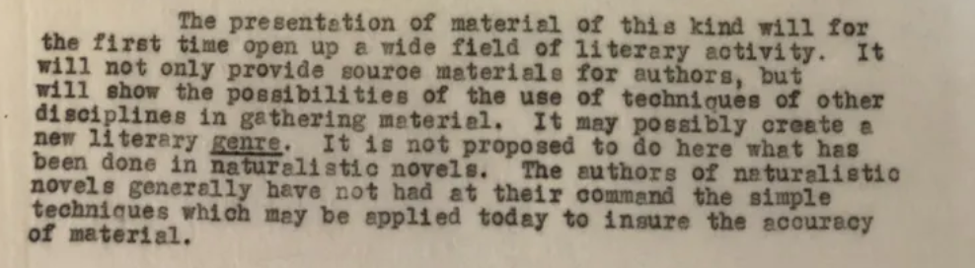
July 11, 1938, Collection 3709, Folder 1087

Slide 10
Authenticity Rendered By:
Removing the presence of the writer from the life histories
Adding written dialect to indicate speech patterns

Slide 11
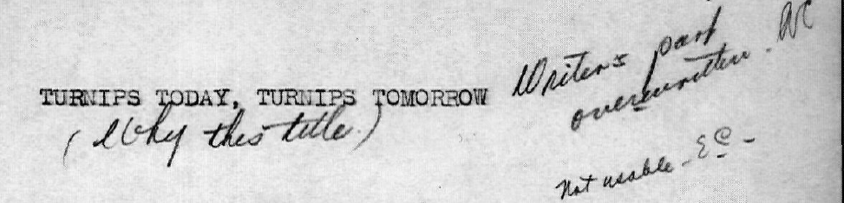
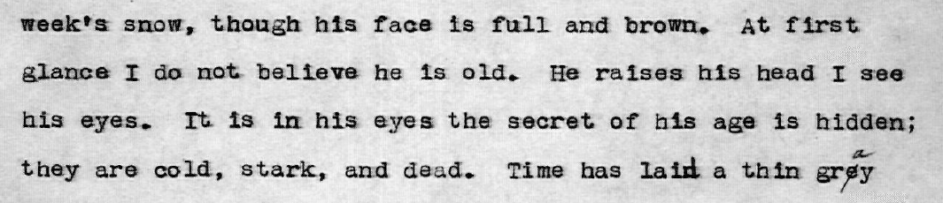
Collection 03709, Folder 148

Slide 12
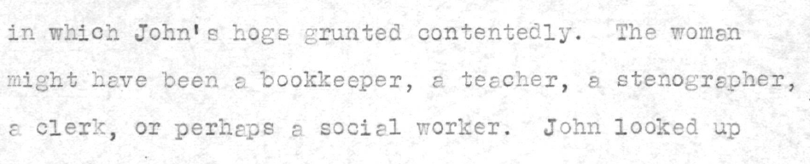
Collection 03709, Folder 659

Slide 13
Collection 03709, Folder 1027

Slide 14
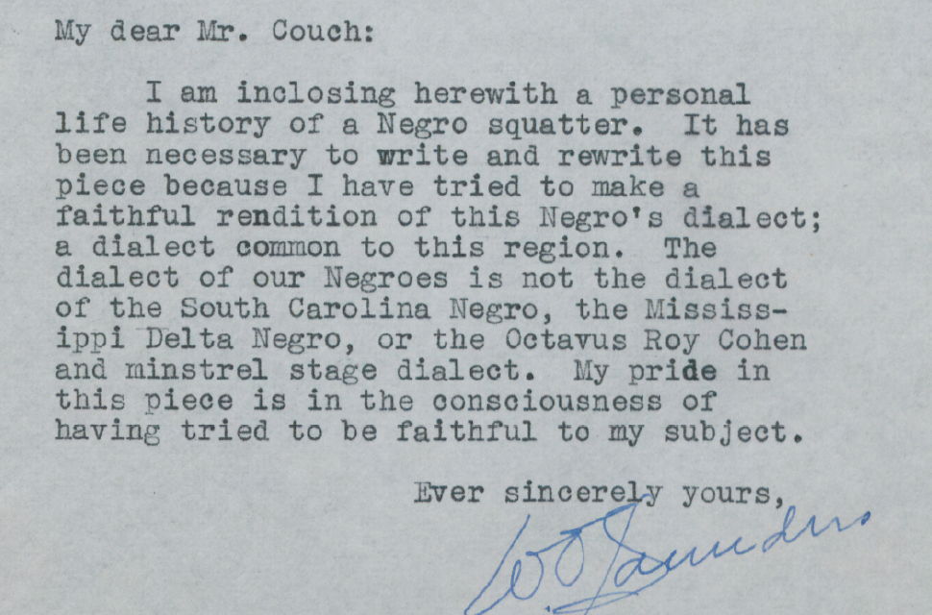
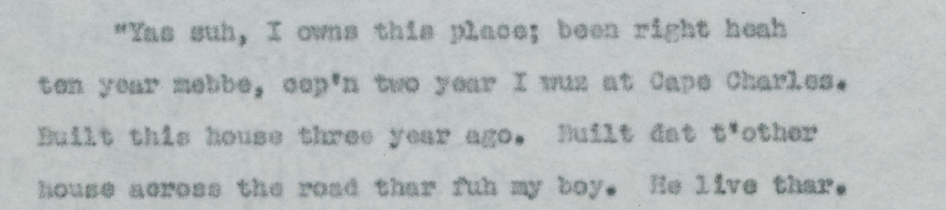
Collection 03709, Folder 741

Slide 15
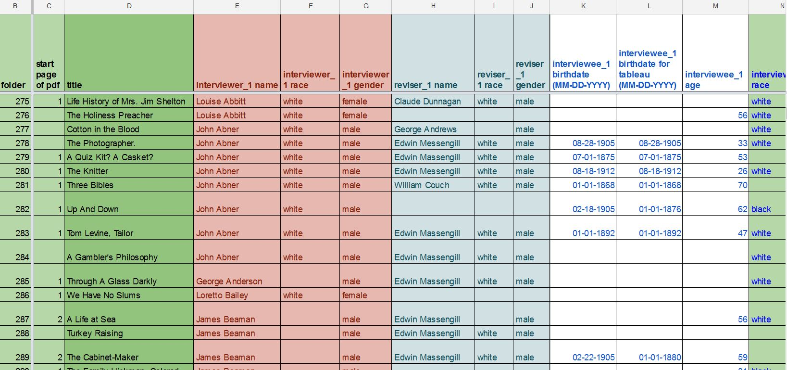

Slide 16
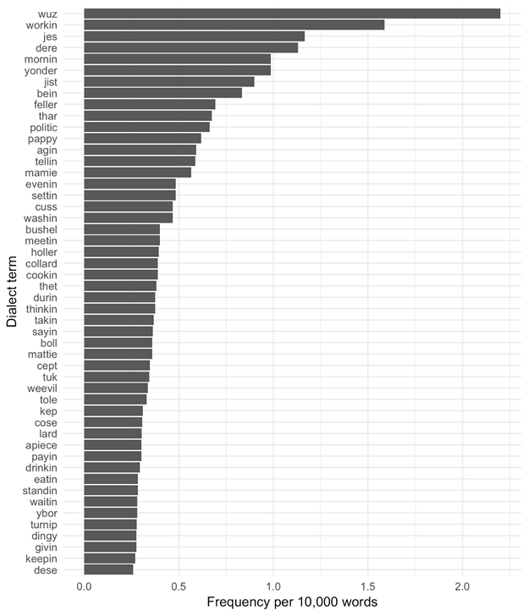
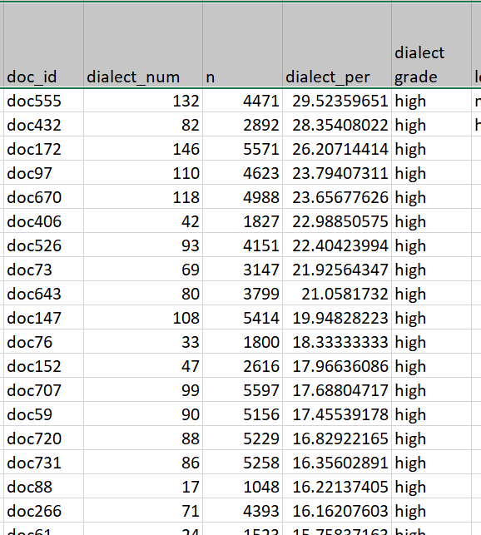

Slide 17
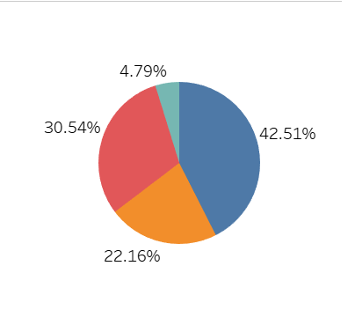
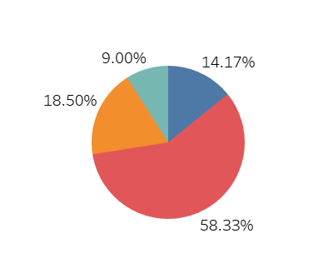
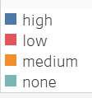
Race of Interviewee and Written Dialect
African American
White

Slide 18
Thank you!
crivard@email.unc.edu

